Slide 1


Notes:
Today, I want to have a conversation about a major change that’s going on in this country. As the American population ages, an unprecedented wave of longevity for those over age 65 could present a crucial need for long-term care solutions. And I want to make sure that you know all of the facts beforehand in order to have the best, possible plan in place.
These shifts in demographics will bring many challenges for you, your loved ones, and for anyone who has to provide care to you and the people you love.
Those challenges are mostly of preparation and foresight – not just on an individual level… BUT also on a family level and a society level.

Slide 2



Long-Term Care Solutions
Notes:
This is all about Living Longer and Better Lives. A lot of our conversation today is going to be about care – specifically longevity planning.
Fortunately, Americans are living longer. My hope for all of my clients is that they age with dignity, unburdened with worries about income, portfolio performance, or whether you’ll have sufficient resources to provide for your eventual care.
INSERT ANECDOTE: (At this point, the Advisor should share a personal story about someone they love or know who was affected (negatively or positively) by longevity planning. Then, encourage your clients to share their personal stories.)

Slide 3
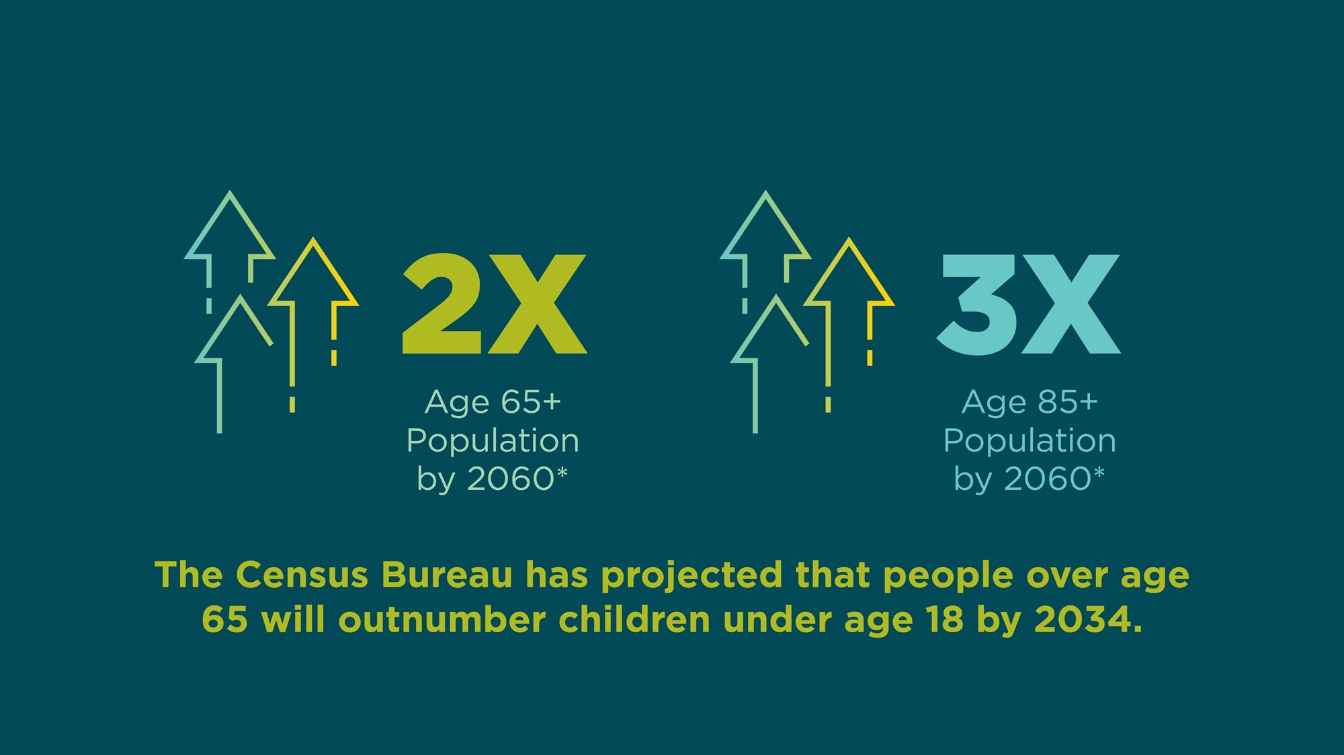
By the Numbers
Notes:
What’s at stake: A disproportionate share of population growth will be in the 65+ and 85+ age ranges – in the very near future.
As society ages, we’ll have to weather a storm that’s already building – placing pressure on budgets, families, and communities.
When we look at those numbers – they obviously play into why we should be planning for longevity solutions – both for long-term care, as well as annuities.
Remember: Most of our systems (Social Security and Medicare for example) were designed in a time when there were four or five workers for every one dependent on the system. This is going to add strain to already stretched budgets.

Slide 4
Who needs care?
42% of people over age 85
58% of women over 65
10% of Americans over 65 have dementia
38% of people over 85 have dementia
Notes:
42% of people over age 85
At some point in their lifetimes, 58% of women over 65 will need assistance
10% of Americans over 65 have dementia
38% of people over 85 have dementia
Average life expectancy after an Alzheimer’s diagnosis: 8-10 years
63% of dementia caregivers who have had to change working hours, or leave work unexpectedly and are worried about their personal finances

Slide 5

Longevity
Longevity is the multiplier of all risks.
42% of people over age 85 need long-term care services.*
Notes:
It’s great news that our beloved parents, grandparents, friends, and neighbors are living longer into their golden years.
The challenge will be planning for care, as well as the emotional and financial costs of providing that care, because the population over age 85 is set to triple by 2060.
The future demand for care is both predictable and immense, but facilities and infrastructure are just not prepared. Currently, Alzheimer’s or memory care units, represent just 1 out of every 20 nursing home beds in the U.S.

Slide 6


Solo Agers
Notes:
We can’t really talk about planning without considering the unequal impact on women. Far too many households default to one spouse being responsible for all things financial.
A longer life expectancy presents challenges, especially when it comes to a greater likelihood of long‑term care needs.
Also, women may have to face their healthcare needs alone.
Solo agers (older, single adults with no spouse or partner) are more vulnerable financially, medically, and emotionally, and need to strongly consider a thorough longevity plan before a medical event occurs.
From an unequal standpoint, there’s a lot of data, but it really comes down to woman vastly outnumbering men at older ages. Since we know that 40% of those 85+ require care – and women represent the lion’s share of people over 85.
There’s a lot of pressure, and a different kind of pressure, on the portfolio and reliable sources of income.
Bear in mind, too that Solo Aging is NOT just gender specific. Single, divorced, widowed – now, or more than likely in future. For example, a big age difference for a couple, or one spouse/partner who is healthier than the other.

Slide 7

The Dilemma
Women generally earn less.
However, they also need those dollars to last longer because of a longer life expectancy.
Notes:
Solo Agers are growing as a population – requiring more planning for their care program, as well as adding pressure on their portfolio to support their income needs for longer.
Women generally earn less. However, they also need those dollars to last longer because of a longer life expectancy.
Almost twice as many women (65+) live alone – compared to men.
Women who work full‑time, year‑round, earn only 83% of what men earn.
Among seniors over age 75, women are 60% more likely than men to need help with one or more activities of daily living, such as eating, bathing, dressing, or getting around their own home.

Slide 8



Three Factors to Consider
Solo Agers
Females
Tax Legislation
Notes:
1. Solo Agers: Those who are single, divorced, or widowed – as they will likely have fewer informal caregivers.
2. Females: Women tend to live longer, and the longer they live, the greater chance for long-term care needs.
3. Tax Legislation: As more states are proposing income tax for residents without long-term care insurance, your need to be aware of these possible changes while your still have options to buy coverage before your state sets a "coverage-in-force-prior-to" date.

Slide 9

Life Insurance
Notes:
You might think your time to purchase life insurance has passed, but the versatility of the products might suggest otherwise.
Significant improvements have been made to living benefit riders, such as long-term care, critical illness, and chronic illness.
These riders make it possible for you to accelerate all or a portion of your death benefit to cover required costs of care.
Then, any remaining amount of your contract will be paid, usually income tax free, to your beneficiaries.

Slide 10




Life Insurance Features
Notes:
1. Death benefit exceeds premiums paid
2. Survivorship policies protect couples at second death
3. Tax-free death benefit if care is not needed
4. Viable option to replenish lost wealth for clients who cannot qualify for traditional long-term care policies or riders

Slide 11

Long-Term Care
Insurance
11

Slide 12
Five Questions to Consider
Do you anticipate a need for extended, home healthcare?
Which assets would you sell first to cover the costs?
Do you have sufficient earnings and retirement savings?
Do you have other intentions for what you’ve saved over the years?
Are you currently caring for an aging parent?
Notes:
Your clients’ responses to these five questions will help determine if LTC insurance is an appropriate option.
Based on your or your family’s health history, do you anticipate a need for extended home health care?
2. If an incident requiring long-term health care were to occur, which assets would you sell first to cover the costs?
3. Do you have sufficient earnings and retirement savings to afford long-term care costs without insurance?
4. Do you have other intentions for what you’ve saved over the years?
5. Is your client currently caring for an aging parent?

Slide 13






The Importance of LTC Insurance
Individuals who
purchased insurance:¹
Average total care need
(including home care, etc.):²
1/3 want to protect
assets/estate
2/3 feared cost of insurance would increase
1/5 wanted to ensure
affordability of service
Men = 2.2 years
Women = 3.7 years
1/5 needs LTC care for
longer than five years
Notes:
Many insurance companies recommend buying LTC insurance sooner rather than later for a lower-cost policy. However, health is another major reason to consider coverage at younger ages. If your clients are not in good health, or have a family history of dementia, they may not qualify for LTC insurance or may have limited options.

Slide 14

Linked Benefits
70% of long-term care claims begin as home care.
Notes:
There are insurance solutions that clients may find more palatable than the “use it or you lose it” aspect of traditional long-term care insurance. Linked Benefit (sometimes called LTC hybrid solutions) offer great value and benefits as part of a financial plan.
Linked Benefit products are life insurance contracts integrated with long-term care benefits. In Linked Benefit policies, the death benefit is not the primary focus but enables a way to ensure the client doesn’t lose their premium dollars should they not have a care need.
If the client does need care, Linked Benefit products include care coordination resources from the insurance carrier.

Slide 15




Linked Benefit Features
Notes:
Linked Benefit products evolved to offer numerous, flexible-payment options, a welcome contrast with the original single premium plans of years’ past. The flexibility makes these products viable for a greater number of clients, both those with a lump sum available and those who want to pay over time.
Features include:
Tax-free LTC benefits exceed premiums paid, often by two or three times
Long-term care resources
Care coordination from the insurance carriers
Tax-free death benefit if care is not needed

Slide 16

Annuities
The Other Half of Rainy-Day Planning
Notes:
Longevity planning involves more than just long-term care planning. Annuities offer clients the peace of mind of income they cannot outlive, and accumulation for their future needs.
It’s been said that life insurance protects against dying too soon.
If that’s true, then annuities protect against living too long.
Annuities may offer clients better potential rates of return when compared to their current savings – especially if the savings are in traditional bank products, such as savings accounts, CDs, and money market.

Slide 17


The Strength of Annuities
Notes:
Most retirees are concerned about two things:
1. Running out of money.
2. The risk of market volatility during retirement.
Annuities are the only investment vehicle that can solve both of those problems.

Slide 18

The Ugly Truth
More than one third of defined contribution plan participants may run out of money in retirement.*
Notes:
Without having explicit lifetime income insurance, more than one third of defined contribution plan participants may run out of money in retirement.*
When it comes to annuities, many participants reported they were scared to surrender a large portion of their assets and lock that money away.
Investors are hungry for solutions that provide protection from downside risk and guaranteed income, and annuities are one of the only vehicles that can solve both problems.
You can take advantage of a positive index performance. An indexed annuity with a decent participation rate will help you significantly reduce your risk, but also give you the growth you absolutely still need.

Slide 19





Annuity Benefits
Notes:
1. Safety: Fixed and Fixed Index Annuities (FIAs) offer a guarantee of principal for you backed by the full faith and credit of our company.
2. Tax deferral: Annuity contracts grow tax-deferred, so you can earn interest three ways:
a. Interest on initial premium
b. interest on the interest
c. interest on the dollars that would otherwise have to be paid in taxes
3. Liquidity: Most annuities have a contingent deferred sales charge (CDSC) which declines on a contractual schedule over the first five to 10 years. This ensures that 100% of your premium is working from day one, without an up-front sales charge.
4. Protection from creditors: In most states, annuities are protected from creditors, unlike most other investments.
5. Income: Annuities are the only financial instrument that can pay an income that cannot be outlived. Almost all annuities offer a host of annuitization options, which allows you to exchange the current contract value for a series of guaranteed payments.

Slide 20



Annuity Features
Notes:
1. Tax-deferred growth: and higher returns than fixed savings.
2. Living benefits: if needed for long-term care.
3. Bypass probate: for the named beneficiary as part of the client’s overall plan.

Slide 21
Takeaways
Now’s the time to plan for eventual care needs.
Government programs are under intense, demographic pressure and may not provide the anticipated support.
Be aware of unique concerns for Solo Agers and how those needs can be mitigated.
Plan to have income that you cannot outlive — which also keeps up with inflation.
Notes:
The American population will clearly look very different in decades to come. Living longer and better lives in presents an opportunity previous generations were denied – to share life experiences, meet other generations, and learn about history from those with firsthand experience or memories.
However, longevity will clearly be one of the biggest stories of the 21st century. Including:
(SHOW: Animation on slide)
Now's the time to plan for eventual care needs.
Government programs are under intense, demographic pressure and may not provide the anticipated support.
Be aware of unique concerns for Solo Agers and how those needs can be mitigated.
Plan to have income that you cannot outlive — which also keeps up with inflation.
If you are inspired to plan, there are exceptional options available to help mitigate the potential impact on your portfolio of an unplanned need for long-term care – or to build into your plan the peace of mind of knowing you will never outlive your income.
These solutions may secure a lifetime income stream and create an estate plan that enables you to be prepared for these changes, to live and adapt through your golden years, and still leave a legacy for your heirs.

Slide 22

GCF02454 | 5950293

